Slide 1
Chapter 11:
Data Warehousing
Modern Database Management
Jeffrey A. Hoffer, Mary B. Prescott, Fred R. McFadden

Slide 2
Objectives
Definition of terms
Reasons for information gap between information needs and availability
Reasons for need of data warehousing
Describe three levels of data warehouse architectures
List four steps of data reconciliation
Describe two components of star schema
Estimate fact table size
Design a data mart

Slide 3
Definition
Data Warehouse:
  A subject-oriented, integrated, time-variant, non-updatable collection of data used in support of management decision-making processes
  Subject-oriented: e.g. customers, patients, students, products
  Integrated: Consistent naming conventions, formats, encoding structures; from multiple data sources
  Time-variant: Can study trends and changes
  Nonupdatable: Read-only, periodically refreshed
Data Mart:
  A data warehouse that is limited in scope

Slide 4
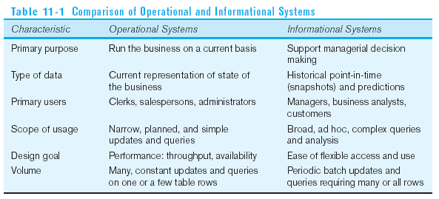
Need for Data Warehousing
Integrated, company-wide view of high-quality information (from disparate databases)
Separation of operational and informational systems and data (for improved performance)

Slide 5
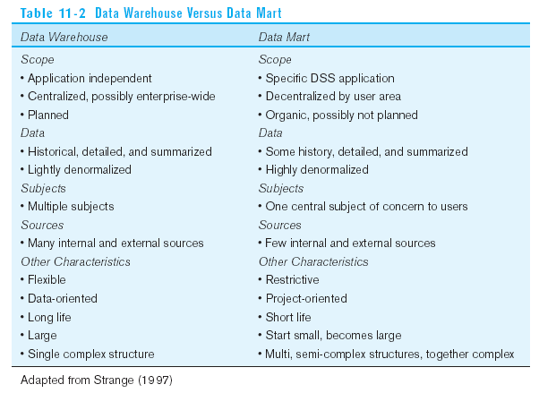

Slide 6
Data Warehouse Architectures
Generic Two-Level Architecture
Independent Data Mart
Dependent Data Mart and Operational Data Store
Logical Data Mart and @ctive Warehouse
Three-Layer architecture
All involve some form of extraction, transformation and loading (ETL)

Slide 7
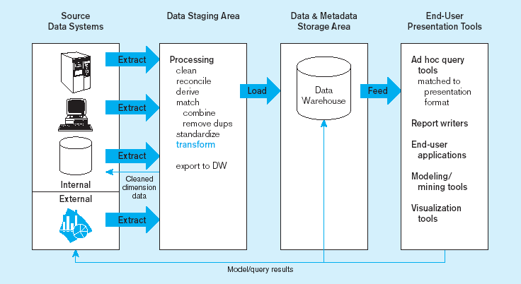
Figure 11-2: Generic two-level data warehousing architecture
L
One, company-wide warehouse
T
E
Periodic extraction ➔ data is not completely current in warehouse

Slide 8
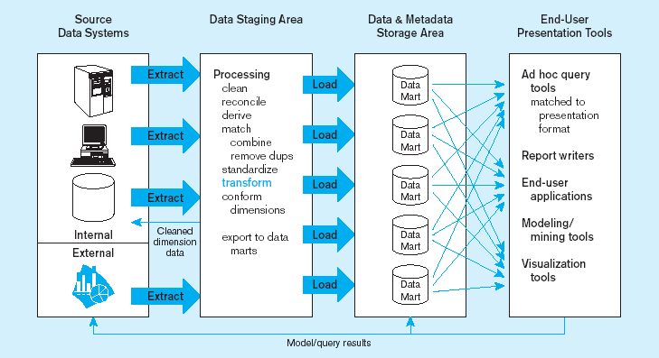
Figure 11-3 Independent data mart data warehousing architecture
Data marts:
Mini-warehouses, limited in scope
L
T
E
Separate ETL for each independent data mart
Data access complexity due to multiple data marts

Slide 9
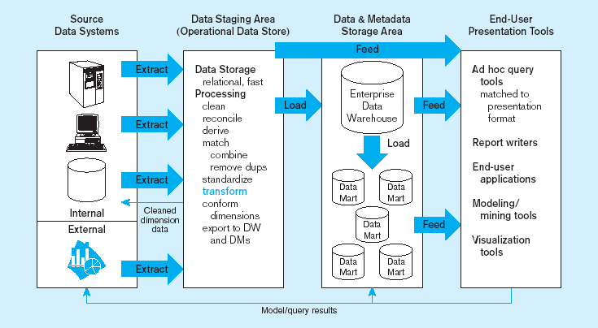
Figure 11-4 Dependent data mart with operational data store: a three-level architecture
ODS provides option for obtaining current data
L
T
E
Simpler data access
Single ETL for
enterprise data warehouse
(EDW)
Dependent data marts loaded from EDW

Slide 10
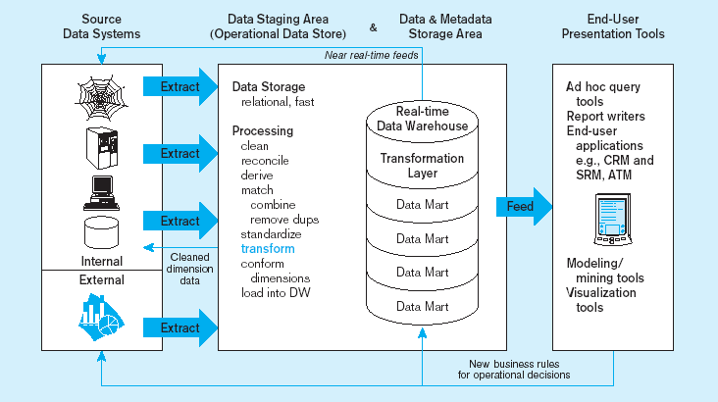
Figure 11-5 Logical data mart and real time warehouse architecture
ODS and data warehouse are one and the same
L
T
E
Near real-time ETL for
Data Warehouse
Data marts are NOT separate databases, but logical views of the data warehouse
➔ Easier to create new data marts

Slide 11
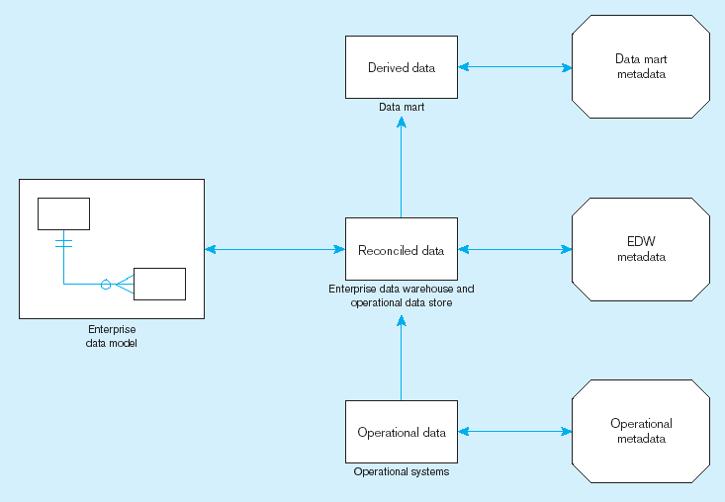
Figure 11-6 Three-layer data architecture for a data warehouse

Slide 12
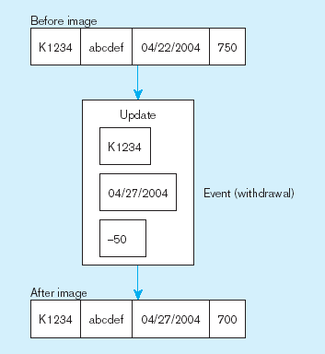
Data Characteristics
Status vs. Event Data
Figure 11-7 Example of DBMS log entry
Status
Event = a database action (create/update/delete) that results from a transaction
Status

Slide 13
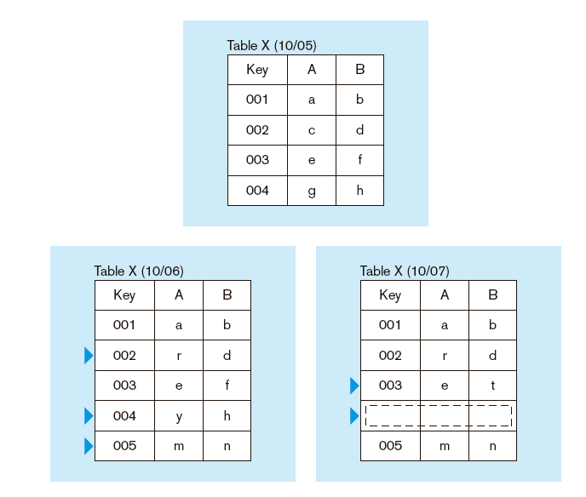
Figure 11-8 Transient operational data
Data Characteristics
Transient vs. Periodic Data
With transient data, changes to existing records are written over previous records, thus destroying the previous data content

Slide 14
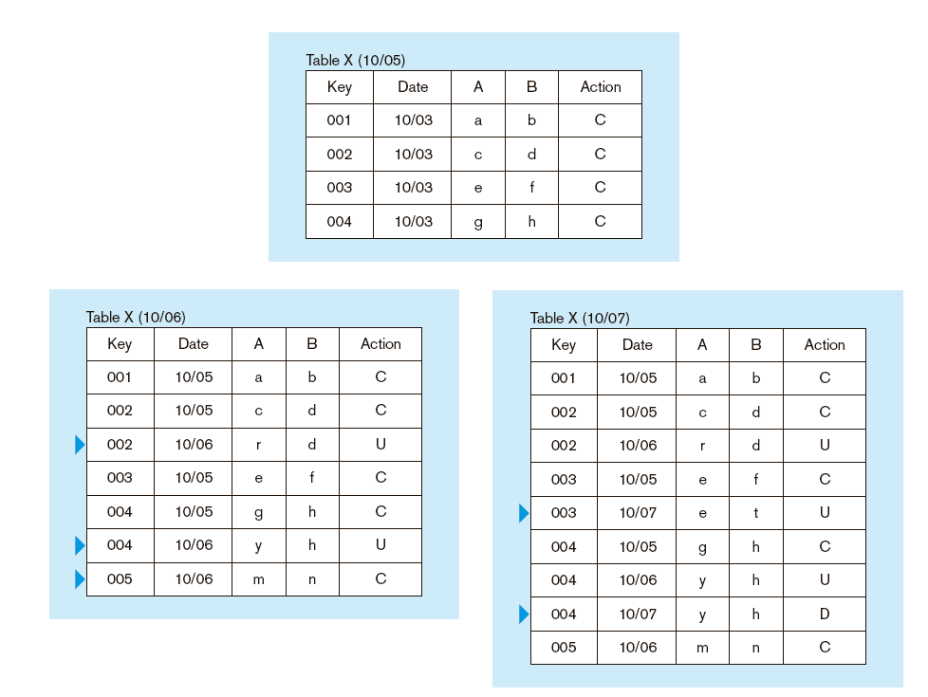
Figure 11-9: Periodic warehouse data
Data Characteristics
Transient vs. Periodic Data
Periodic data are never physically altered or deleted once they have been added to the store

